Slide 1


ENGLISH LEVEL B1 - II
Lesson 06
TALKING ABOUT LIFESTYLES
Notes:
Teacher notes: •Explain the lesson objective clearly.

Slide 2

01
Talk about different lifestyles
02
Learn new words and talk about daily activities
03
Work in pairs and in groups
ENGLISH LEVEL B1 - II
Notes:
Teacher notes: •Explain the lesson objective clearly.

Slide 3


TALKING ABOUT LIFESTYLES
LET’S TALK ABOUT LIFESTYLES!
Look at the pictures and answer the questions.
1
What do you see in the pictures?
2
Which lifestyle do you like? Why?
3
What kind of lifestyle do you have?
Notes:
Teacher notes:
Encourage students to describe what they see.
Have students work in pairs or small groups.

Slide 4
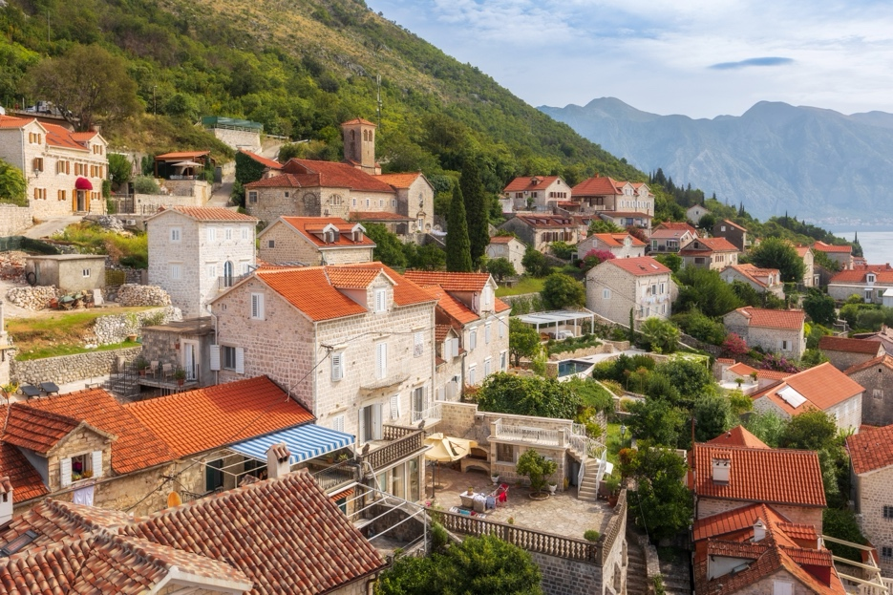
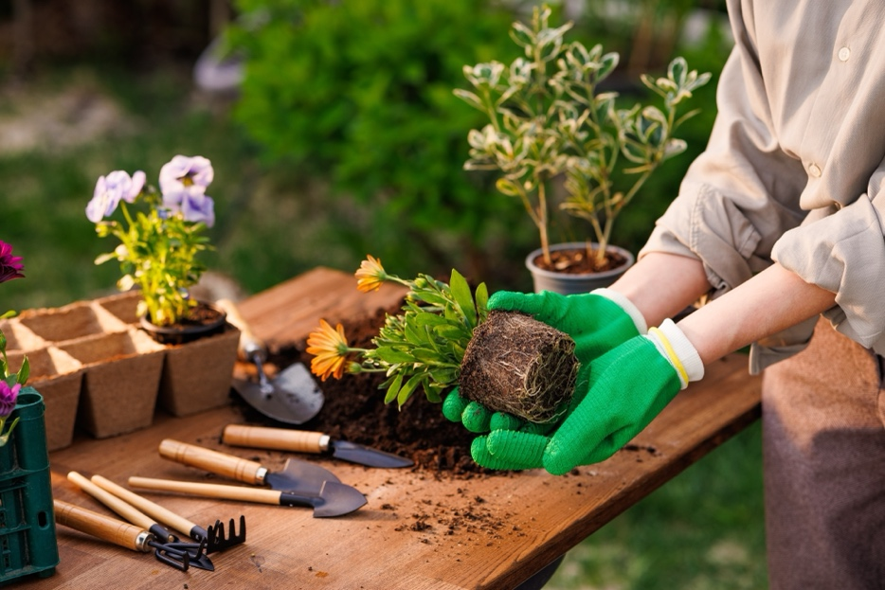
TALKING ABOUT LIFESTYLES
Vocabulary:
Verbs:
Vocabulary words:
Village, city life, social life, healthy, busy, peaceful, nature, decision.
Verbs:
to enjoy, to adopt, to miss, to regret, to do (some) gardening, to be familiar with.
Notes:
Teacher notes:
Read the words aloud and ask students to repeat.
Have students work in pairs to complete the sentences.

Slide 5
TALKING ABOUT LIFESTYLES
PRACTICE THE VOCABULARY!
Vocabulary:
Complete the sentences with the correct words:
I live in a __________. It is small and peaceful.
She likes __________ because she loves meeting new people.
He __________ to move to a new city. Now he is happy.
A __________ person exercises and eats good food.
She __________ waking up early for work every day. It is difficult.
They __________ a dog from the animal shelter. Now it is part of the family.
We often spend time __________ because we love fresh air.
Notes:
Teacher notes:
• Give students time to complete the sentences.
• Review answers as a class.
• Ask volunteers to read their answers aloud.

Slide 6

TALKING ABOUT LIFESTYLES
Talk with a Partner
Work in pairs and ask each other these questions:
Example Conversation
1
What is your daily routine?
A: What is your daily routine?
B: I wake up at 7 AM. I eat breakfast and go to work. In the evening, I watch TV and sleep early. What about you?
A: I wake up at 6 AM. I go to school, and in the afternoon, I study and play soccer.
B: Do you live a busy or peaceful life?
A: I have a busy life because I study a lot. And you?
B: I have a peaceful life. I live in a small village, and it is quiet.
A: What do you do in your free time?
B: I like to read books and go for a walk. What do you do?
A: I meet my friends and play video games.
2
Do you live a busy or peaceful life?
3
What do you do in your free time?
Notes:
Teacher notes:
Model an example with a student before they start.
Encourage students to give full answers.

Slide 7
TALKING ABOUT LIFESTYLES
Put the Words in Order
Put the words in the correct order:
like / I / social / an / life / active. →_________________________
in / village / I / a / peaceful / live. →_______________________
she / gardening / enjoys / doing. →________________________
always / my / brother / busy / is. →________________________
I / a / prefer / quiet / lifestyle. →__________________________
work / she / after / relaxes. →____________________________
love / I / outside / spending / time. →______________________
Notes:
Teacher notes:
Have students work alone first, then check in pairs.
Ask volunteers to read their sentences.

Slide 8
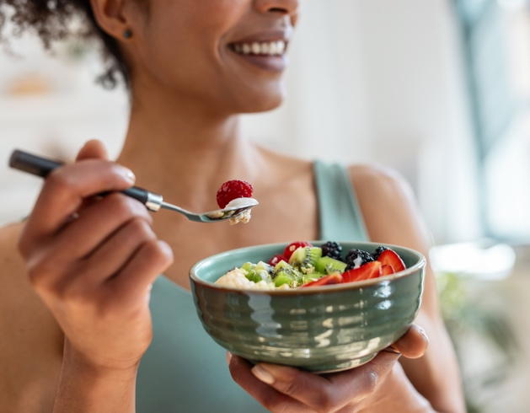
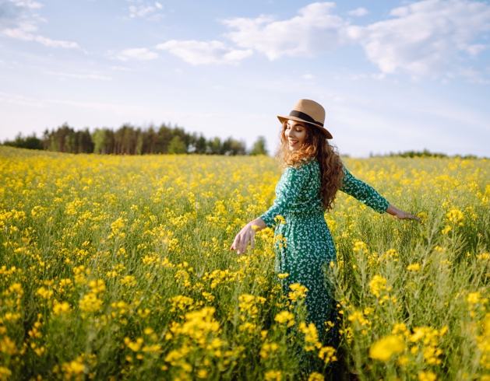
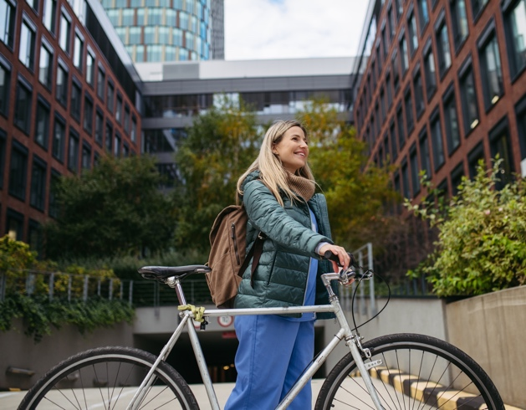
TALKING ABOUT LIFESTYLES
GROUP DISCUSSION
Work in small groups and discuss:
What is a healthy lifestyle?
Do you like living in the city or in the countryside? Why?
What activities do you do every day?
Notes:
Teacher notes:
Encourage students to express their opinions.
Help them use the new vocabulary in their answers.

Slide 9
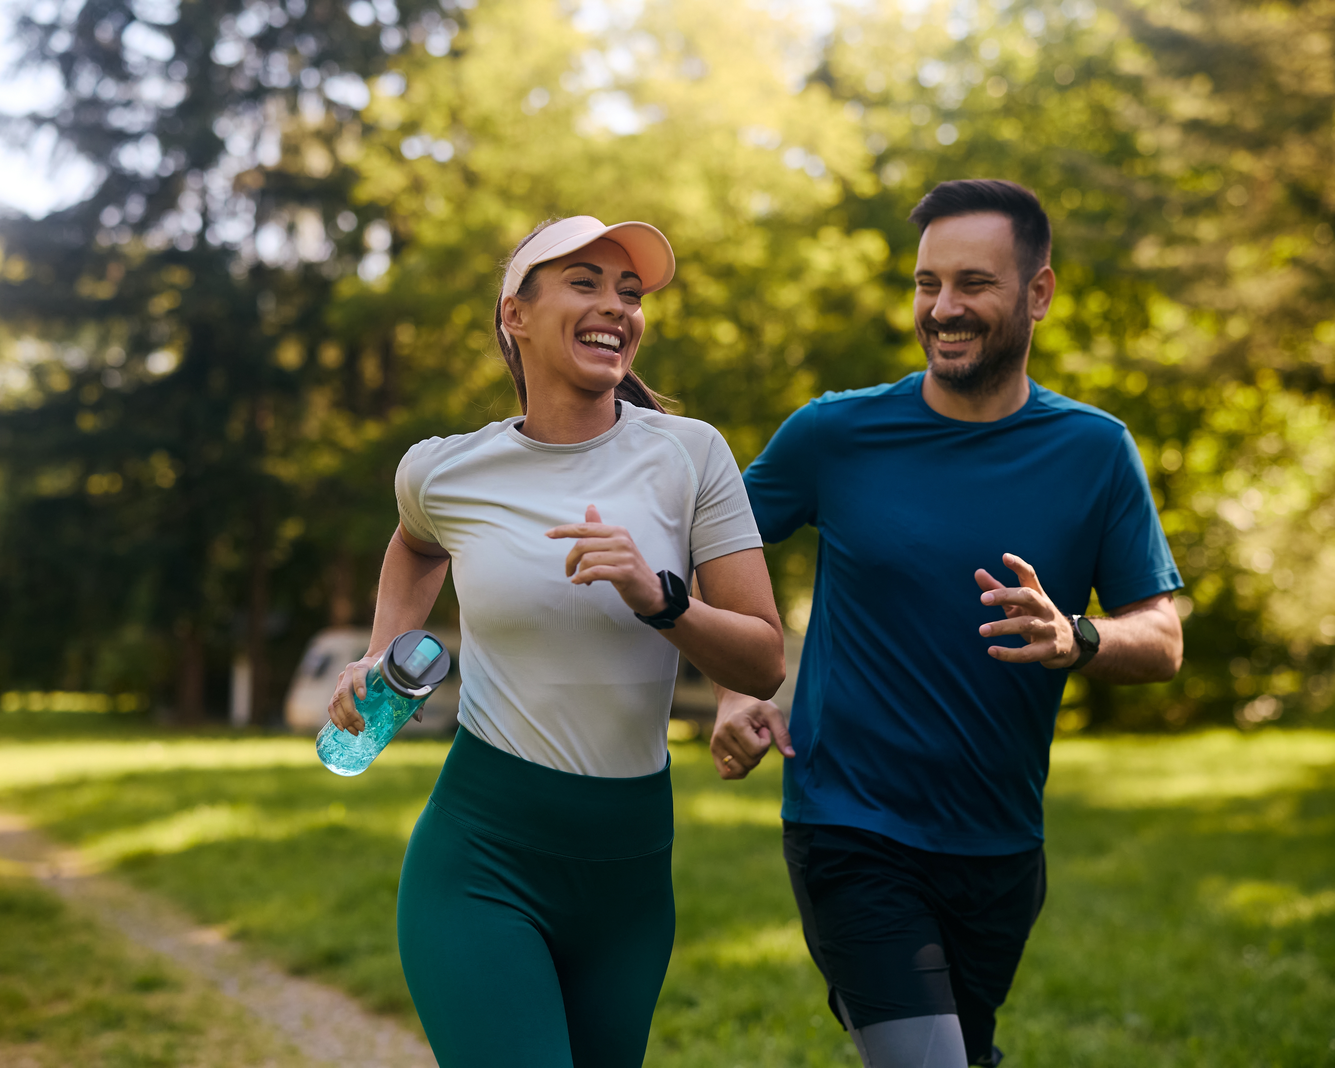

TALKING ABOUT LIFESTYLES
CHECK YOUR LEARNING
Write three sentences about your lifestyle.
Describe if it is busy, peaceful, or active.
Share them in the class chat.
Example:
I have a busy lifestyle because I work and study every day.
I enjoy an active lifestyle because I love playing sports and going for walks.
Notes:
Teacher notes:
•Ask volunteers to read their sentences aloud.
•Provide gentle corrections and encouragement.

